Slide 1
TAG-ORIENTED MARKET ANALYSIS OF ONLINE MARKETPLACES USING VISUAL ANALYTICS
A visual analytics system for market analysis of the desktop game online marketplace “Steam”
Valerio Di Stefano - 1898728
“Engineering in Computer Science” Master’s Degree - Visual Analytics (2023/2024)
Sapienza University of Rome

Slide 2
INDEX
INTRODUCTION
DATA
VISUALIZATIONS & ANALYTICS
TREEMAPS
HISTOGRAMS
PARALLEL COORDINATES VIEW
TAGS RANKING
GENERAL TAGS INFO
TAGS SIMILARITY SCATTERPLOTS & CHORD DIAGRAM
TAGS SCATTERPLOT / BUBBLE CHART
GENERAL GAMES INFO
GAME RESULTS
TAGS TIME SERIEs
RELATED WORKS
FOOD & BEVERAGE CASE STUDY
VISUAL ANALYTICS FOR COMPETITIVE INTELLIGENCE
OTHER RELATED WORKS
USE CASES & INSIGHTS
INTENDED USERS AND USE CASES
USE CASES & INSIGHTS EXAMPLES
CONCLUSIONS AND FUTURE WORKS

Slide 3
INTRODUCTION

Slide 4
MARKET ANALYSIS vs MARKET RESEARCH
Market Analysis
The activity of gathering information about conditions that affect a marketplace.
Studies the attractiveness of a market (degree to which a market offers opportunities to an organization).
Market Research
The activity of gathering information about consumers' needs and preferences.
Aimed at identifying the needs of the market, the market size and the competition.

Slide 5
VISUAL ANALYTICS & MARKET ANALYSIS
Visualizations allow more users to understand data and insights
Business data is often relegated to specific data analysts and data analytics division in companies
Visualizations make complex data more accessible
Visualization allow to identify markets/customers trends and patterns
Interactive data exploration allows to dive deeper into specific aspects of the market

Slide 6
ONLINE MARKETPLACES
Digital hubs where buyers and sellers meet to trade goods and services
Opposed to businesses’ physical retail locations and stores.
Globalization and digital transformation led to a wide spread use of e-commerce platforms, online stores, digital goods/services marketplaces.
Covid-19 pandemic accelerated the digital transformation and led to a shift in consumer behaviors, from physical to online.

Slide 7
THE LITERATURE
Various publications on companies/industries business data visualizations.
Few research publications on visual analytics solutions for market analysis and market research (centered around specific markets and industries).
Almost no research publications on visual analytics solutions for market analysis and market research in broad consumer online marketplaces.
Existing solutions focus on traditional businesses and financial markets.

Slide 8
ABSENT LITERATURE - POSSIBLE REASONS
Lack of publicly available data
➡ Businesses don’t share their data to maintain their competitive advantage
➡ Lack of data hinders research developments and system implementations
Integrated business intelligence tools
➡ Online marketplace platforms let their business partners use integrated tools
➡ Integrated tools focus on “internal business intelligence” (no market overview)
➡ External solutions development is discouraged by lack of data and APIs
Business vs Open Research
➡ Existing solutions are often B2B products rather than open research attempts

Slide 9
STEAM’S VIDEO GAME MARKETPLACE
Biggest online distribution platform in the desktop gaming industry
Over 85.000 games and software products
Over 130 million monthly active users (as of the end of 2023)
Owned by Valve
Private american company
$13 billion in revenue in 2022
44% desktop gaming market share (as of the end of 2022)
Online marketplace for digital goods (video games and software)
Presents similar characteristic to online/physical goods/services marketplaces
Diverse products/services offerings
Vendors variety
Search and filter options
Global accessibility
User reviews and ratings
No sharing of financial and business data

Slide 10
DATA

Slide 11
STEAM GAMES DATASET (KAGGLE + PYTHON)
INITIAL GAMES DATASET
Kaggle Dataset: “Steam Games Dataset” (by Martin Bustos)
84.368 unique data items
39 attributes each
29 attributes have simple data values
10 attributes have complex data structures as values (lists of values, list of key-value pairs, list of objects)
No business data attached
No game sales & revenue data
FINAL GAMES DATASET
Python used for processing data
Filtered data items ➡ 73.078 game items
Edited attributes ➡ 17 attributes
Removed 12 non-relevant attributes
Aggregated 4 structured attributes
Kept 11 simple data attributes
Obtained 6 final complex data attributes
(including list of tags)
+ “Estimated copies sold” (Boxleiter Method)
+ “Estimated revenue” (Fixed Price Discount)

Slide 12
GAME TAGS (TAG-ORIENTED SYSTEM)
Every game item can have an associated list of tags
Max 20 tags per game item, taken from a pool of 448 tags
Game publisher defines initial list, Steam platform users can suggest changes
Tags in list are ranked by relevance to the associated game (publisher + users votes)
New “tags dataset” (computed by iterating over all games’ list of tags)
423 tags included (out of 448 total)
Computed name, number of games and tag category (“Genre”, “Sub-Genre”, “Feature”)
Computed t-SNE and MDS coordinates from tags similarity value
(for each pair <x,y> of tags, number of games with both x and y in games’ tags list)

Slide 13
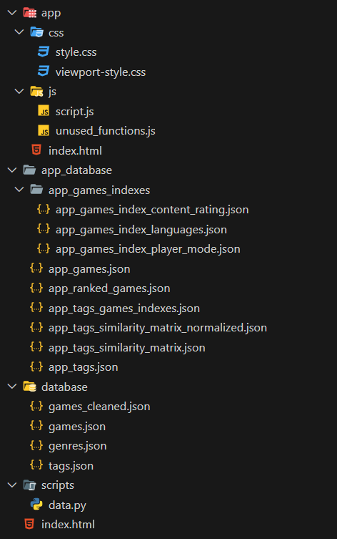
SYSTEM’S FILE STRUCTURE
“dataset” folder ➡ Initial raw data
Kaggle: “games.json” + “games_cleaned.json”
Processed (with Python): “tags.json” + “genres.json”
“app_database” folder ➡ Data used by the system
Main Datasets: app_games.json + app_tags.json (by category)
Other Datasets:
app_tags_similarity_matrix.json (+ normalized version)
app_ranked_games.json (game IDs sorted by attributes)
app_tags_games_indexes.json (tags’ associated game IDs)
Indexed Datasets: app_games_indexes (sub-folder)

Slide 14
VISUALIZATIONS & ANALYTICS

Slide 15
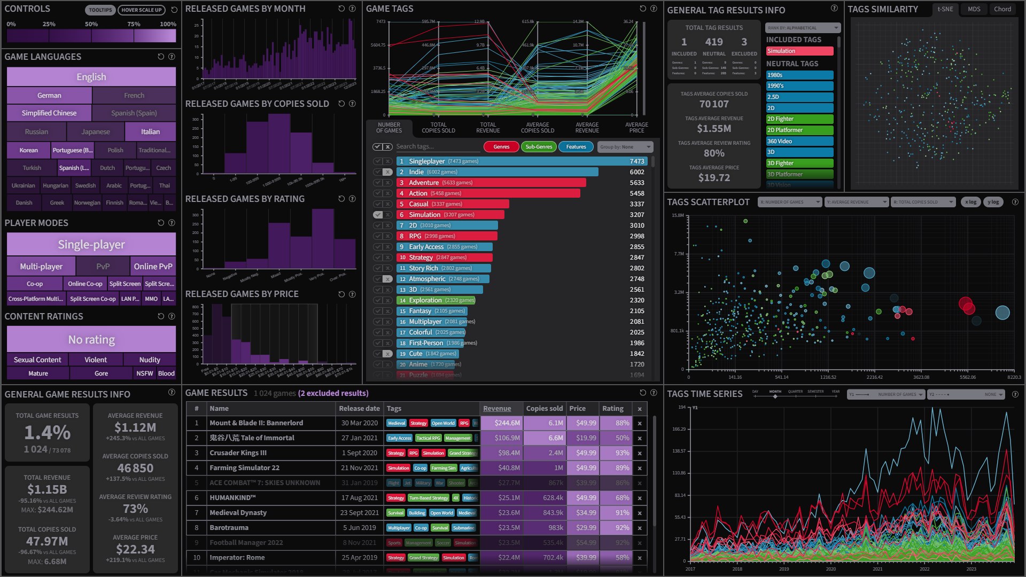

Slide 16
VISUALIZATIONS & SYSTEM FEATURES
10 interactive, coordinated and customizable visualizations
(treemaps, histograms, scatterplots, bubble charts, rankings, parallel coordinate views, chord diagrams, tabular visualizations, line charts, numerical visualizations)
System designed for 4K resolutions ➡ Single sections scaling to full size
Detailed infos & instructions for each visualization (associated “?” button)
QoL Features: general controls, hover tooltips, legends, color consistency
Interleaved or separate games and/or tags exploration

Slide 18
TAG-ORIENTED SYSTEM
System allows for both:
Exploration of game items (based on user defined filters, global and local)
Exploration of tags (based on user defined filters, global and local)
Tag-oriented market analysis
Analysis of data about single tags (rather than single product or product types)
Allows to analyze business data for dishomogeneous products and services
Allows to compare data about overlapping subsets of items
Allows to discover additional global insights (w.r.t. single items analysis)

Slide 19
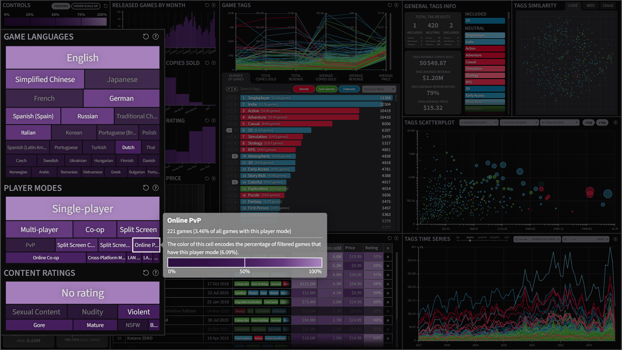

Slide 20
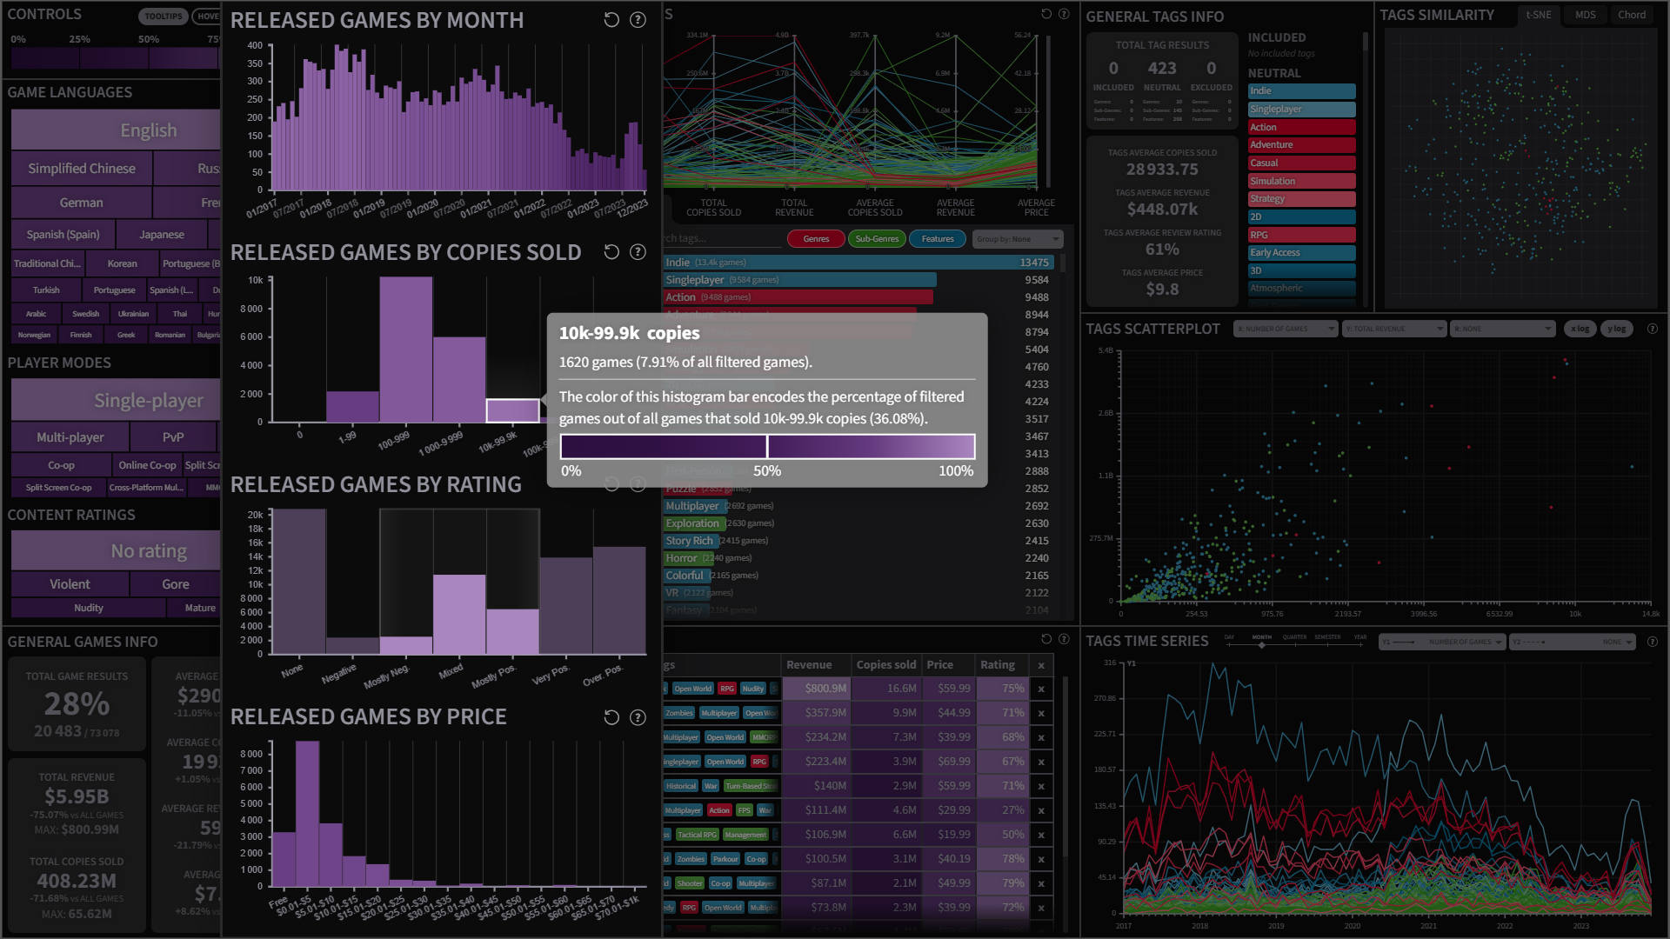

Slide 21
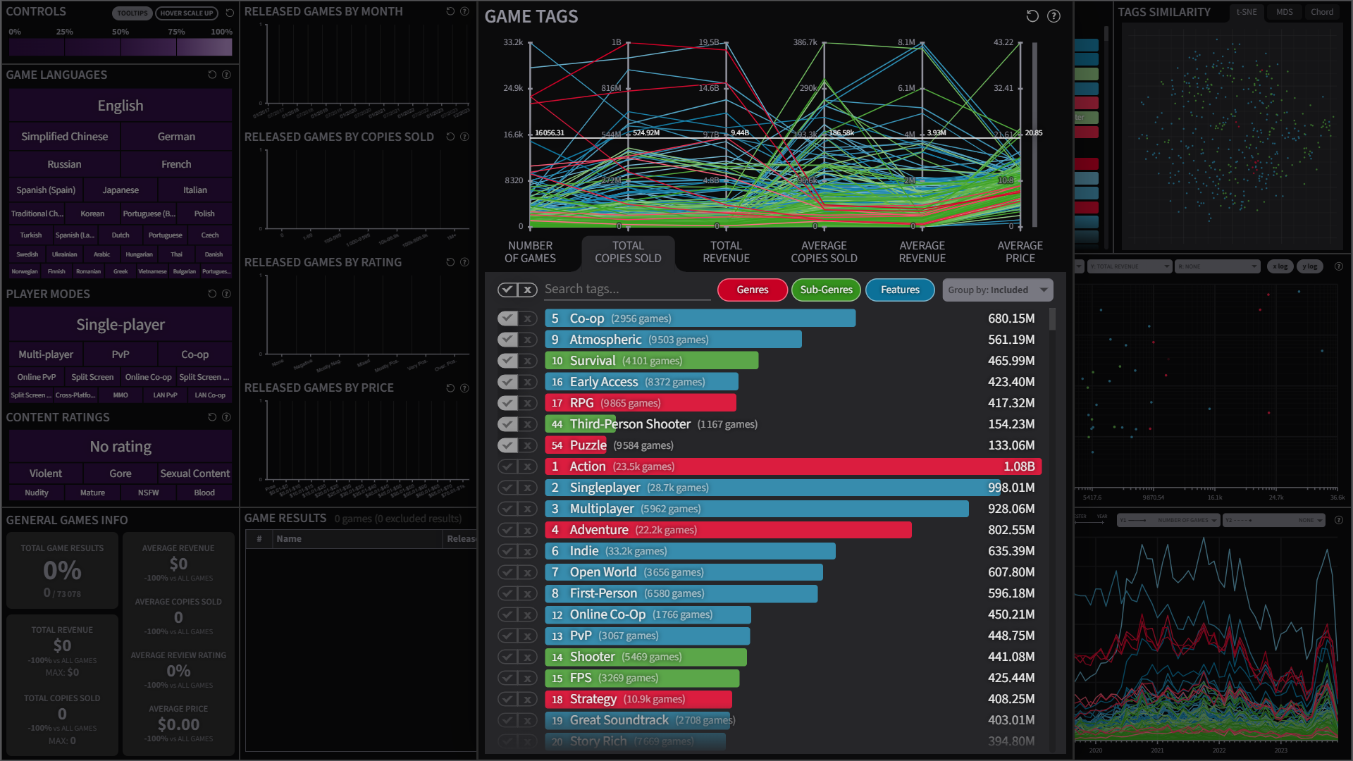

Slide 22
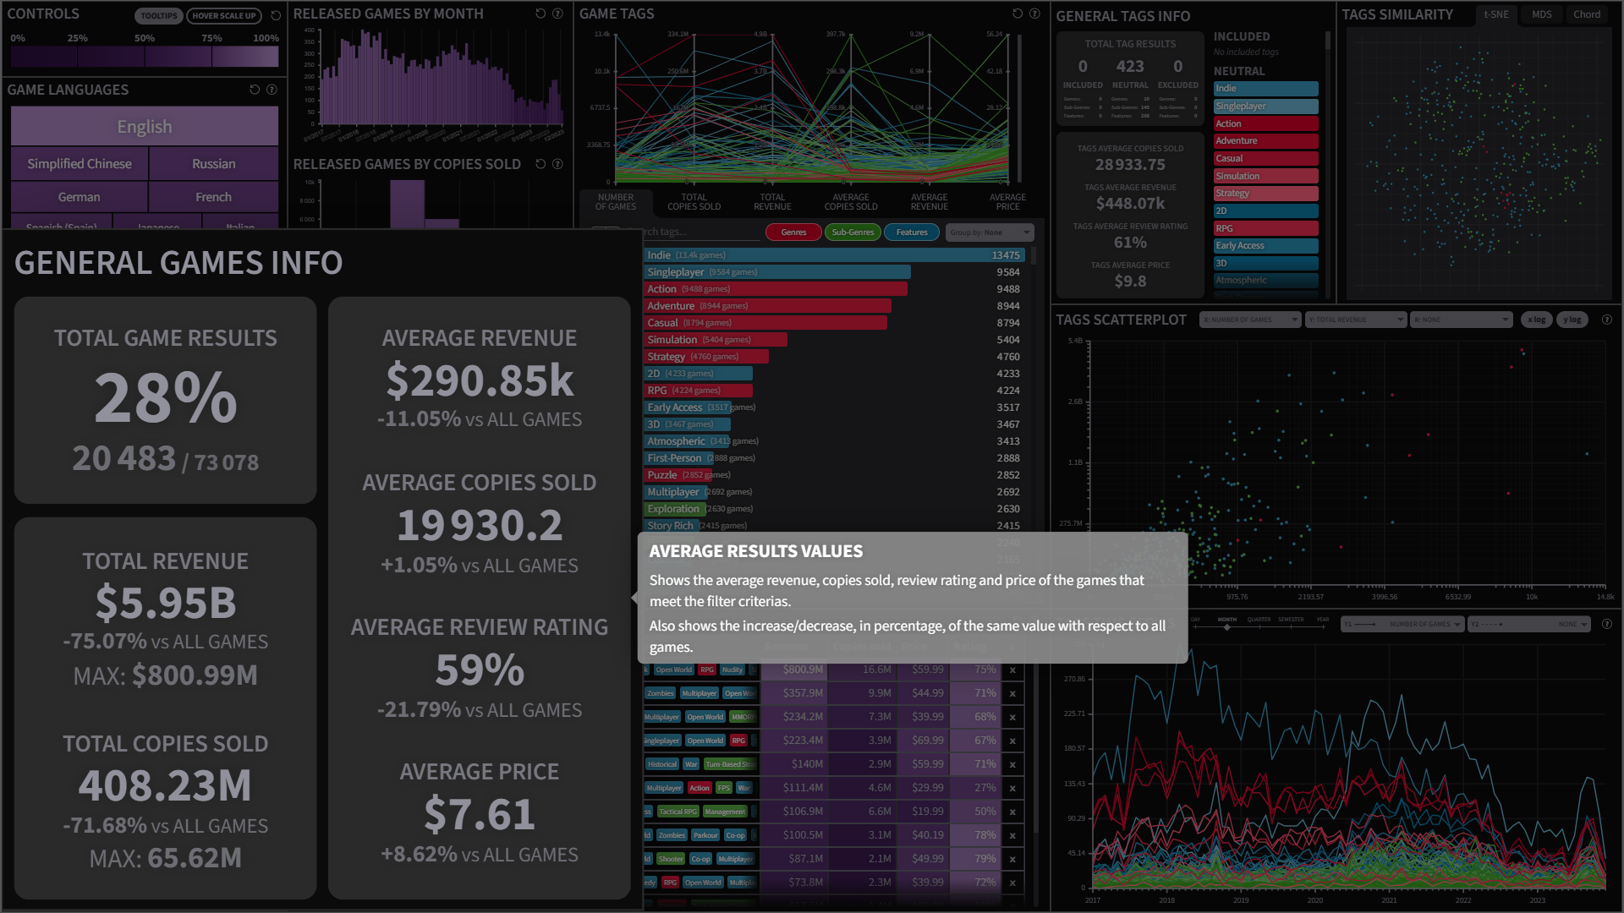

Slide 23
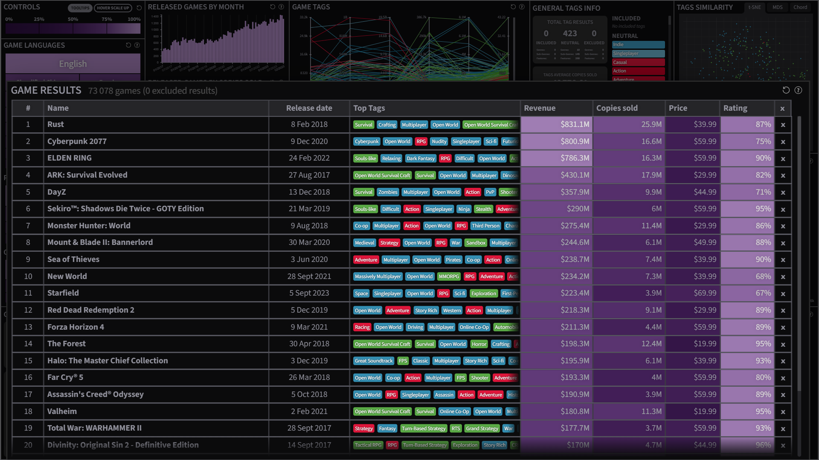

Slide 24
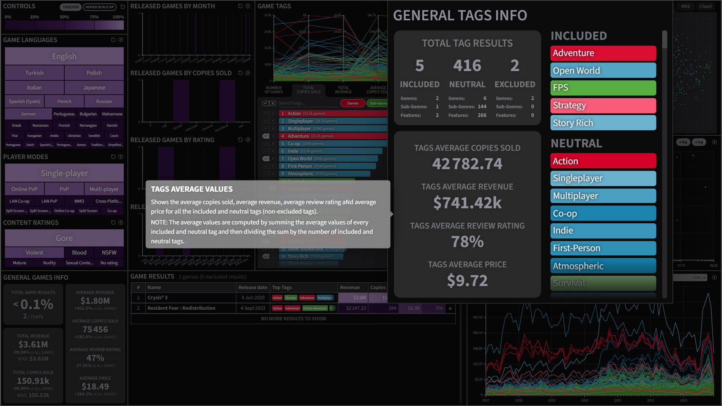

Slide 25
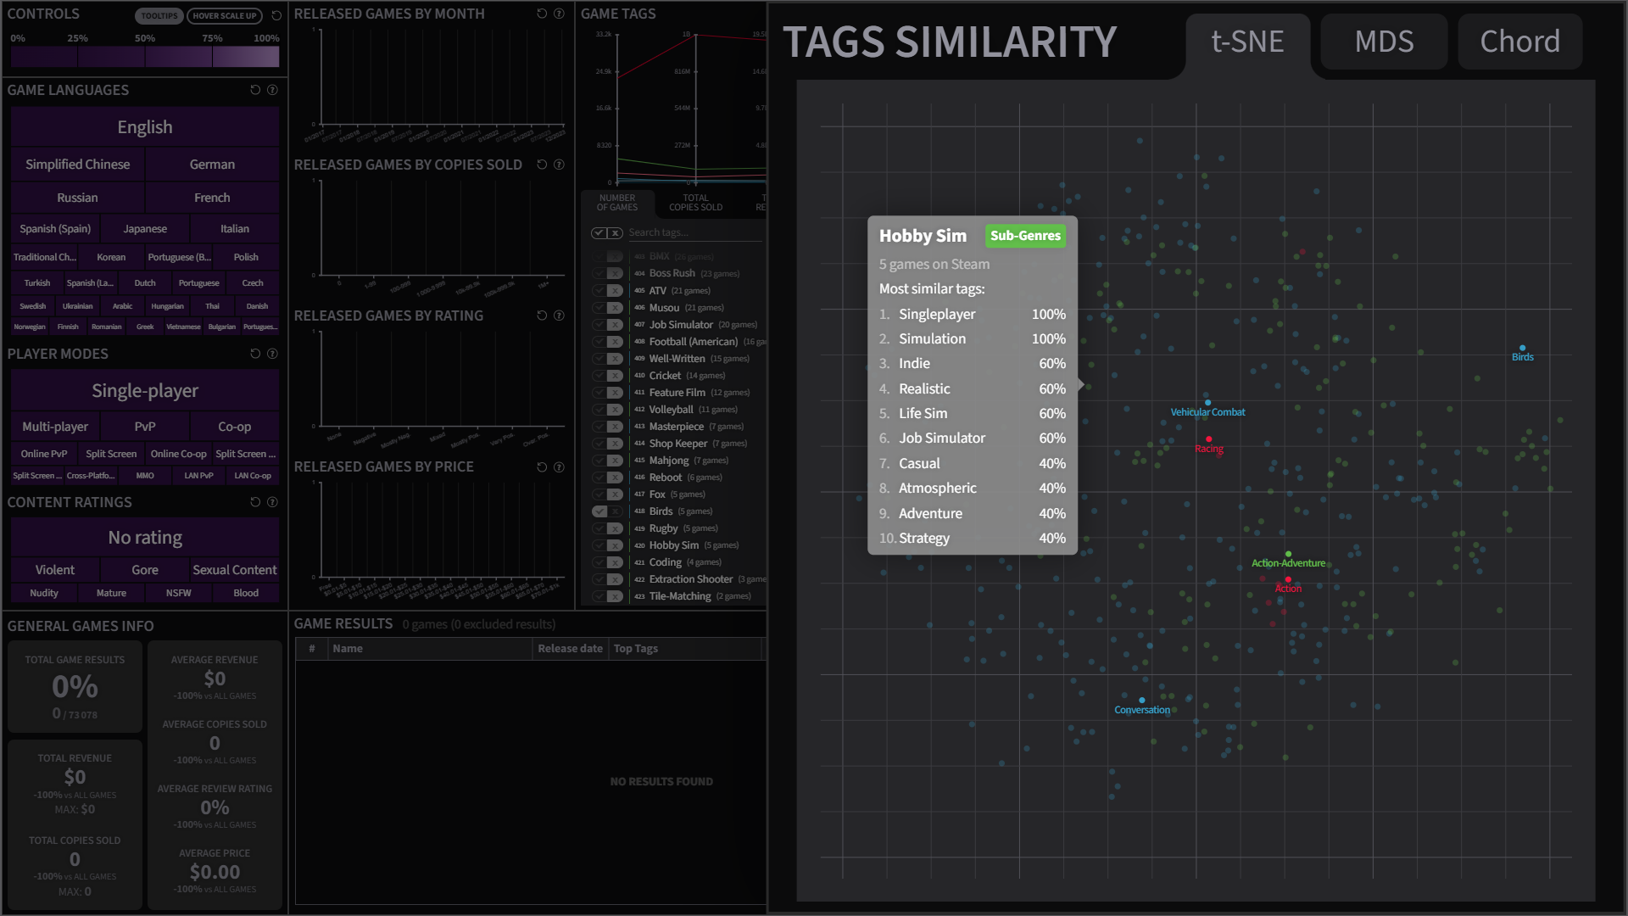

Slide 26
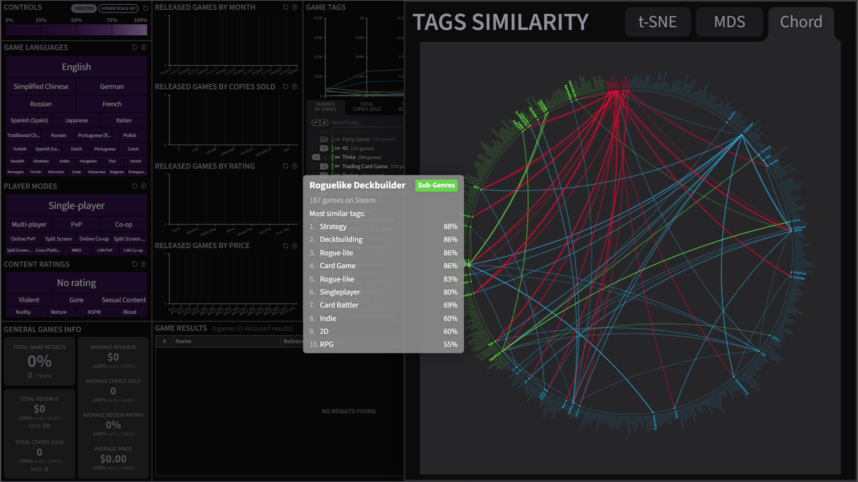

Slide 27
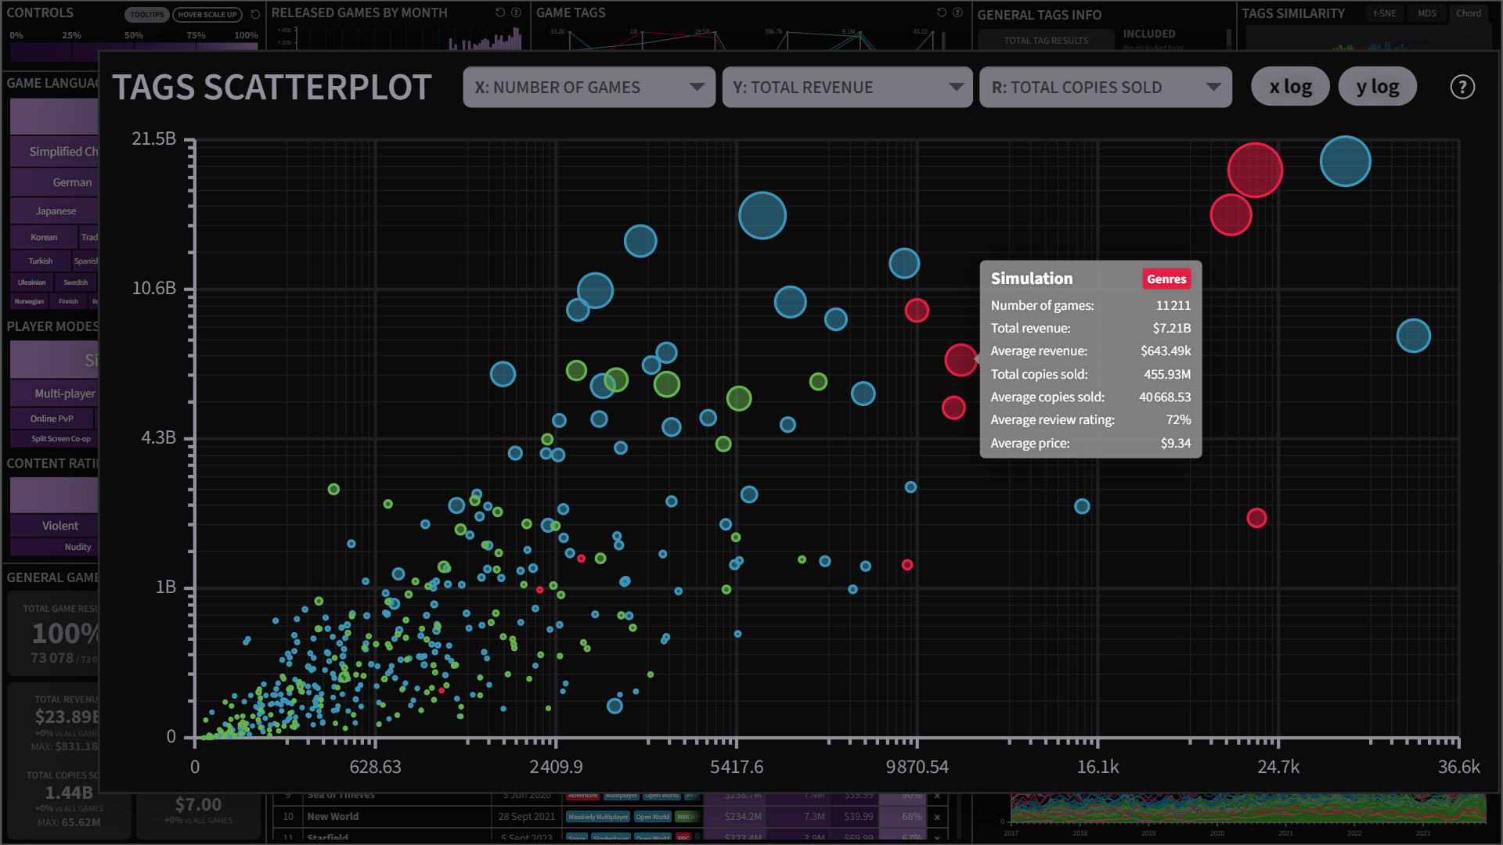

Slide 28
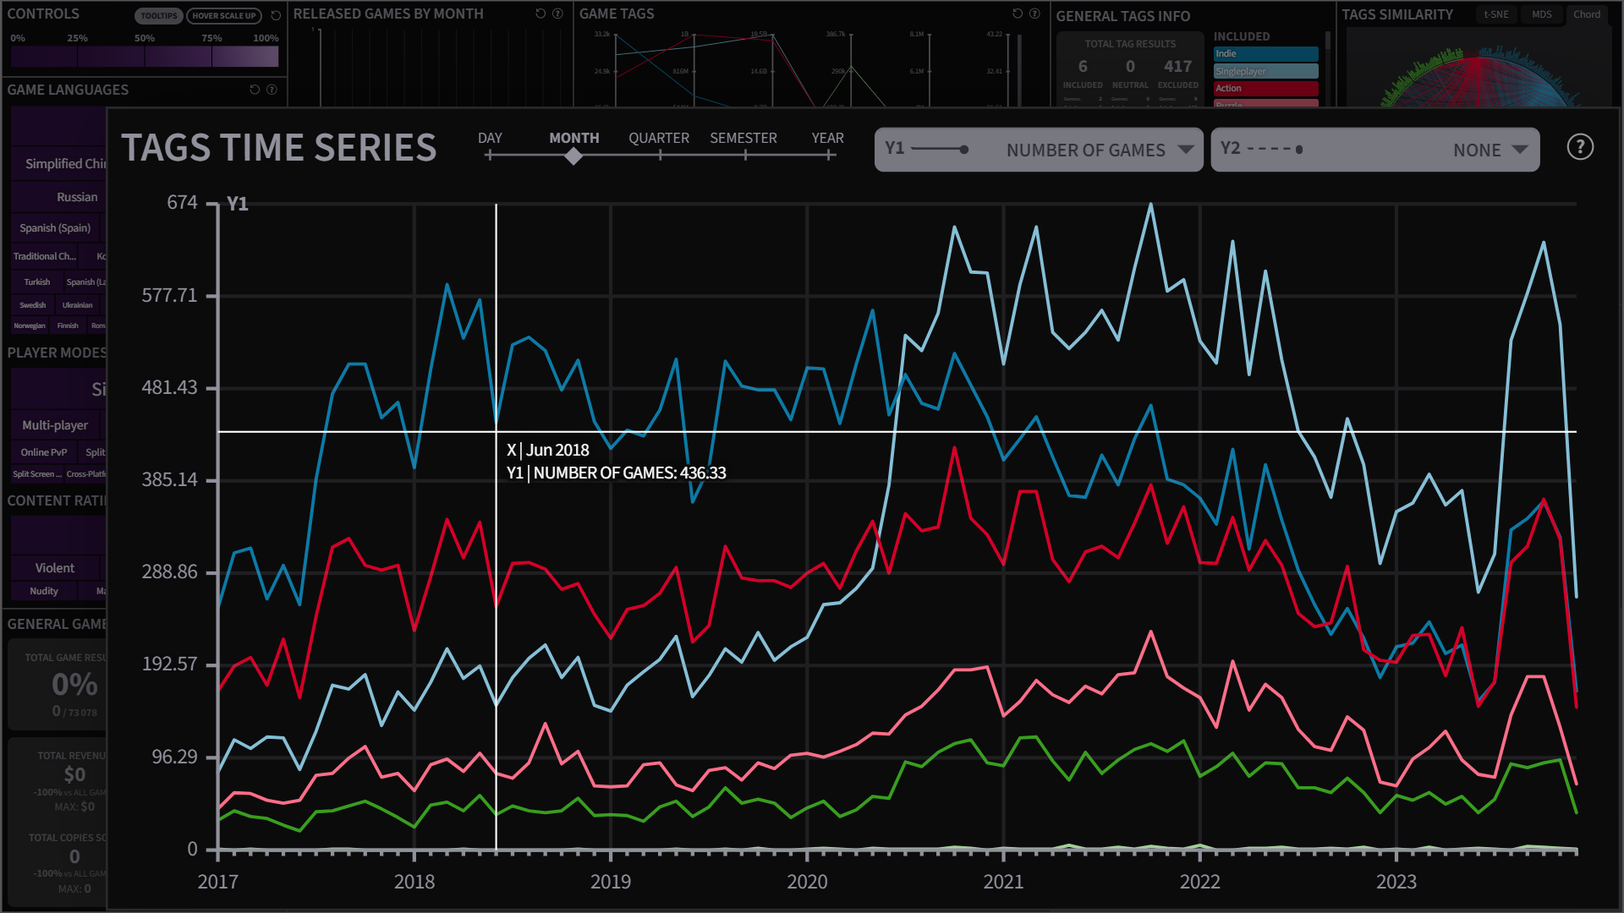

Slide 29
RELATED WORKS

Slide 30

“TAG-REEL” VISUALIZATION
Key Insights
2009 paper by Bae et al. [3]
Radial chart to visualize tag relationships
Circle of points groped by color & radial distance (hierarchical data structure)
Static visualizations ➡ Difficult data exploration
Differences with Proposed Solution
Interactive visualization
➡ Allows for global + local data exploration
➡ Coordinated view customization
Tags only grouped by color (classification by category, no hierarchy)

Slide 31
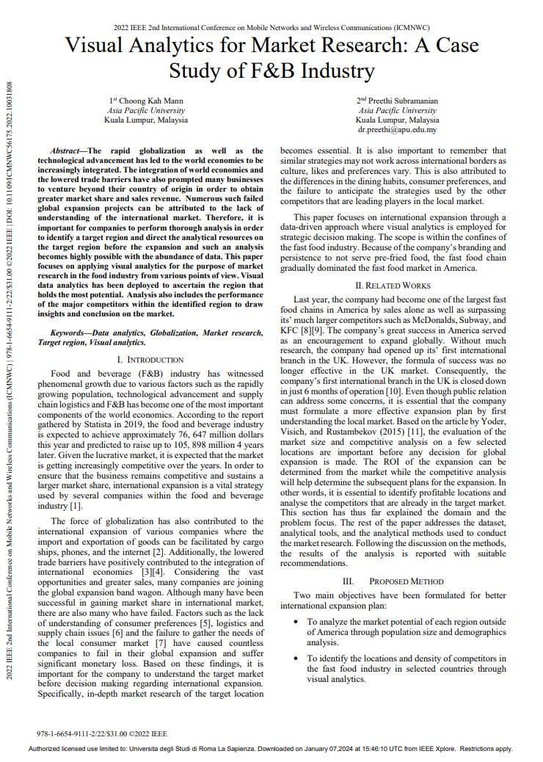
FOOD & BEVERAGE CASE STUDY
Key Insights
2022 paper by Mann et al. [4]
Importance of market research for businesses
Benefits of visual analytics for market research
Weak use of visual analytics (static infographics)
Focuses on traditional business practices
Market analysis focused on competitor analysis
Differences with Proposed Solution
Stronger use of visual analytics solutions (interactive, customizable & coordinated views)
Focuses on online marketplaces (Steam platform)
Employs a tag-oriented market analysis approach

Slide 32
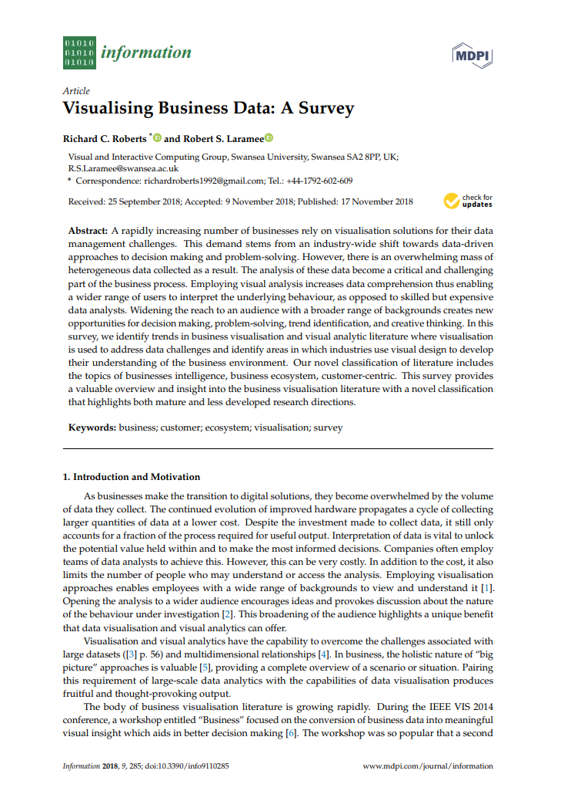
BUSINESS DATA VISUALIZATIONS
2018 survey by Roberts et al. [5]
Analyzes various business-oriented visual analytics solutions grouped in 4 categories (“Business Intelligence”, “Business Ecosystem”, “Customer Centric”, “Financial Visualizations”)
Few visual analytics solutions for market analysis
No market analysis in online marketplaces
➡ 1990s: First online marketplaces appear
➡ 2000s: Globalization & WWW Internet access
➡ 2010s: Boom of e-commerce and online shops

Slide 33
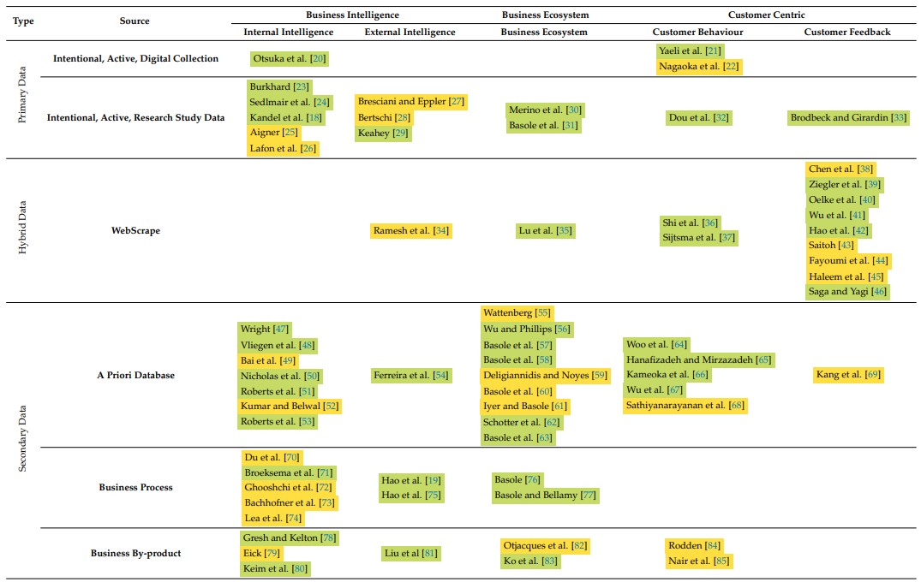

Slide 34
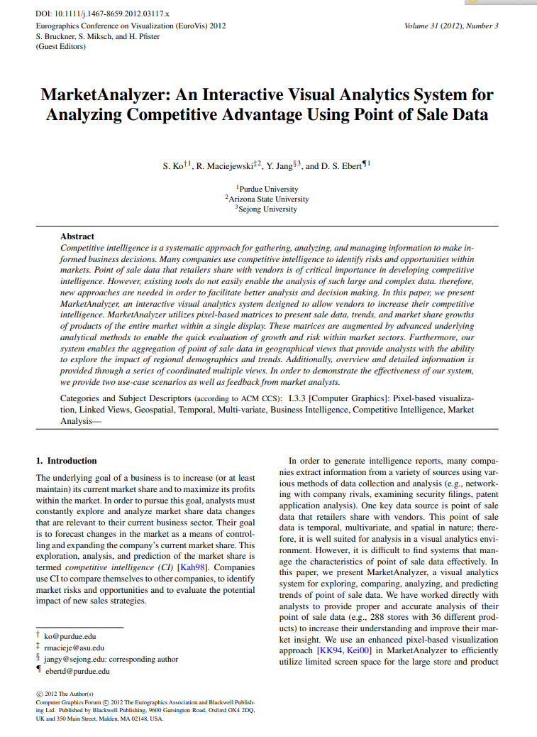
“MARKET-ANALYZER” SYSTEM
Key Insights
2012 paper by Ko et al. [2]
Focuses on “Competitive Intelligence” (competitor analysis to forecast market changes)
Visualizations to compare sales, trends, and growth of a main company and a selected secondary company over a certain time interval
3 entities: “products”, “stores” and “companies”
Differences with Proposed Solution
Focuses on market analysis for online marketplaces
1 entity above all: “products” (tag-oriented analysis)

Slide 35
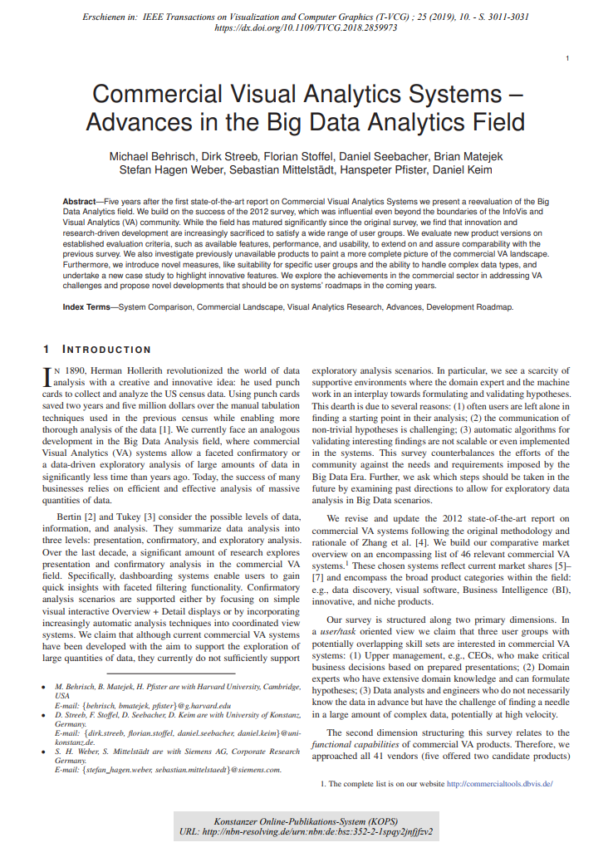
COMMERCIAL V.A. SYSTEMS
2018 survey by Behrisch et al. [1]
Describes the evolution of commercial visual analytics solutions (uses 10 case studies)
Analysis and evaluation of V.A. solutions features, performance, and usability from users’ POV.
Users classified in “upper management”, “domain experts”, and “data analysts/engineers”
Not centered around business data visualizations
Used to guide development of proposed solution
➡ Describes methodologies for evaluating commercial visual analytics systems
➡ Focused on data analysts user group criterias: extensibility, interactivity, and data handling

Slide 36
USE CASES & INSIGHTS

Slide 37
INTENDED USERS & USE CASES (1)
“AAA” GAME STUDIOS
In-house game development
Large number of employees
Various company/business divisions
Multi-platform self-publishing
Priorities:
Conduct in-depth market analysis
Analyze competitors
Assess product-market fit
Visualizing trends and growths
“INDIE” GAME STUDIOS
In-house game development
Small number of employees
Unstructured companies
Single platform self/external publishing
Priorities:
Effective resource allocation
Ensure studios’ financial sustainability
Estimate sales and revenue
Funding (publishing deal/crowdfunding)

Slide 38
INTENDED USERS & USE CASES (2)
GAME PUBLISHERS
Companies funding game studios
Cover studios’ development costs
At game launch:
Recoup initial funding
Get a percentage fee on revenue
Priorities:
Analyze game’s “marketability”
Find customers
Ensure games’ financial success
MORE USERS & USE CASES
Discover genre/sub-genre "niches" (low product supply, high demand)
Evaluate recent market viability of a product being developed
Identify trends to predict gaming market direction (for new products development)
Help with product, price, placement and promotion (4 “Ps” of marketing)

Slide 39
USE CASES & INSIGHTS
System designed to be “versatile” (for different types of users & use cases)
➡ In-depth filters allow to cover a wide range of user needs
➡ Visualizations are highly customizable (w.r.t. plotted data & views layout)
➡ Exploration of both games and tags/genres (locally and globally)
More use cases are possible, and more types of users can discover insights
Multiple insights can be discovered by interacting with the system
➡ Insights examples provided in project report and discussed during demo

Slide 40
CONCLUSIONS & FUTURE WORKS

Slide 41
CONCLUSIONS & FUTURE WORKS
Main Work’s Topic: Visual analytics system for a “tag-oriented” market analysis of online marketplaces centered around the “Steam” desktop gaming distribution platform
Possible research directions and future works:
Translate the visual analytics tag-oriented market analysis methodology to different online marketplaces
Use “official” business data (system used estimated business data)
Extend the tag-oriented methodology to tags with a hierarchical structure (system used tags with no defined hierarchical structure)

Slide 42
END OF THE PRESENTATION
DEMO?

